Slide 1
Smart Contract-Based Access Control for the Internet of Things
Masanari Yamamoto
Yuta Nakamura

Slide 2
Background
Thanks to the rapid advance of networking technologies, a huge number of objects are being connected to the Internet (e.g. IoT)
Strict access control has to be implemented into loT systems
Smart lock system for home doors
Automatic operation vehicle control devices
However, traditional centralized access control schemes have crucial issues
When adversaries hack centralized access control schemes, they can tamper with access control policies
If the centralized server breaks down, the system is not available (e.g. Someone can’t enter his/her house)

Slide 3
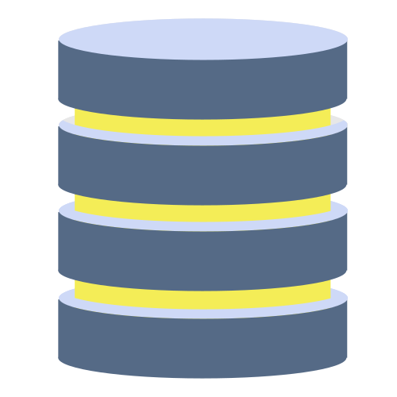
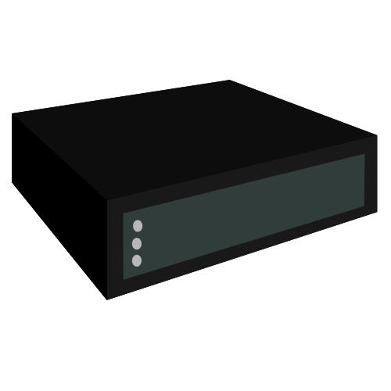



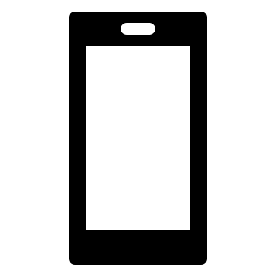




Objective
We propose a distributed access control scheme based on ^{[Y. Zhang,et.al, 2018]}
storage
server
block chain
adversary
P2P network
user device
smart house
Notes:
We use the blockchain to achieve a distributed access control

Slide 4
Originality
Why blockchain?
Trustworthy: prevent malicious users from tampering with access control policies
Distributed: access requests are controlled by all nodes instead of the admin
request
blockchain
storage
server
adversary
request
P2Pnetwork
accept
User device
blockchain
blockchain
Smart house

Slide 5
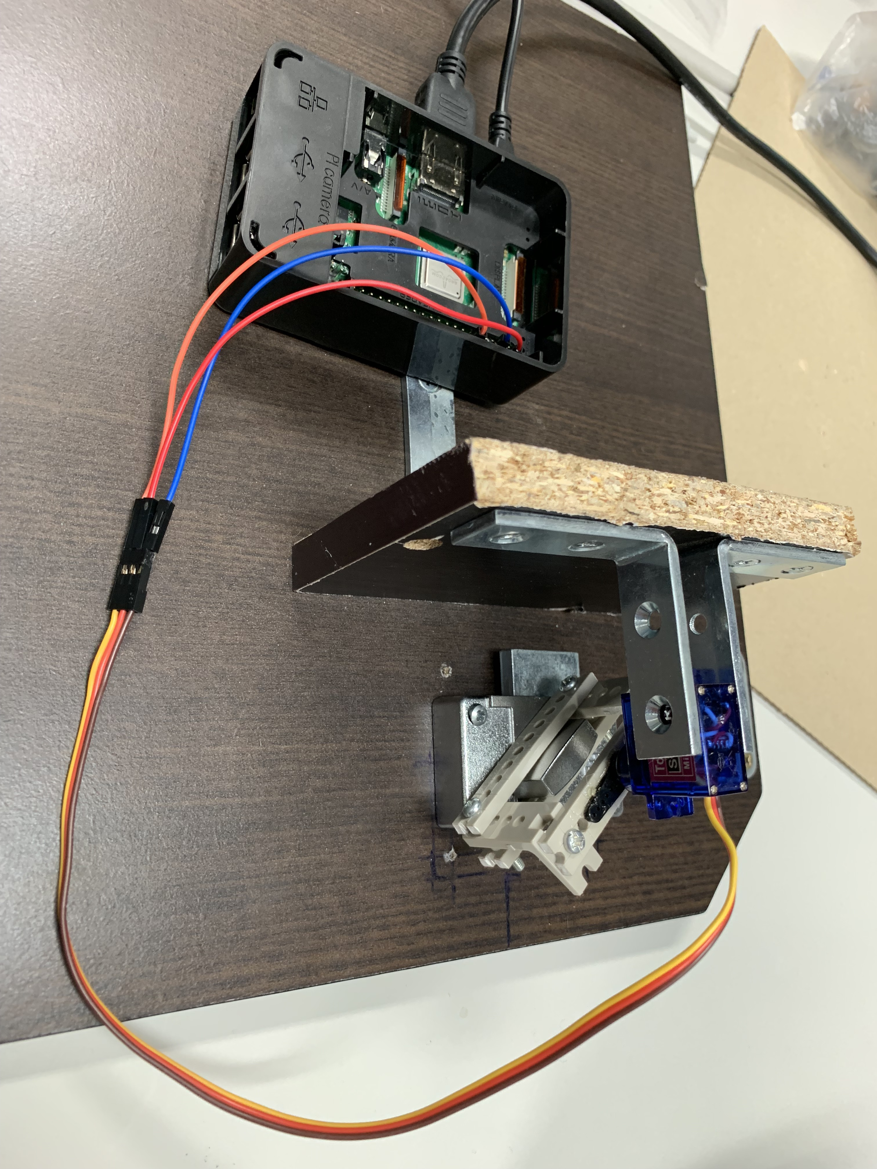
Progress
Jun.--Aug.
Designed our system and structured model
Sep.--Nov.
Implemented the proposed system (coding, testing)
made a smart lock
Deployed and tested the smart lock

